Slide 1
Organising assessment with PBL and progression
Mona Lisa Dahms
Aalborg Centre for Problem Based Learning

Slide 2
What can we say about assessment?
Assessment is ‘the hidden curriculum’ which directs students’ learning
Assessment poses three problems:
Often non-aligned to learning outcomes (LO)
Assessing higher level competences (acc. Bloom) is difficult
Assessing PBL related competences is even more difficult ;-)

Slide 3
1) On constructive alignment
Learning outcomes
Assessment
Learning/teaching activities
Constructive alignment;
Biggs (2003)
Notes:
Constructive alignment – from a different point of view

Slide 4
Research on assessment documents the problem….
Understanding test
Good understanding Failed examination: 0 % | Good understanding Passed examination: 30 %
Poor understanding Failed examination: 25 % | Poor understanding Passed examination: 45 % !!!!
Pass
Fail
Fail
Pass
Exam
Jakobsen and Rump, 1998
Notes:
Arne Jakobsen and Camilla Rump did a research of 10 course at DTU and in 7 of the 10 courses it was possible to compare the exam mark with the mark from the understanding test – here is the result!

Slide 5
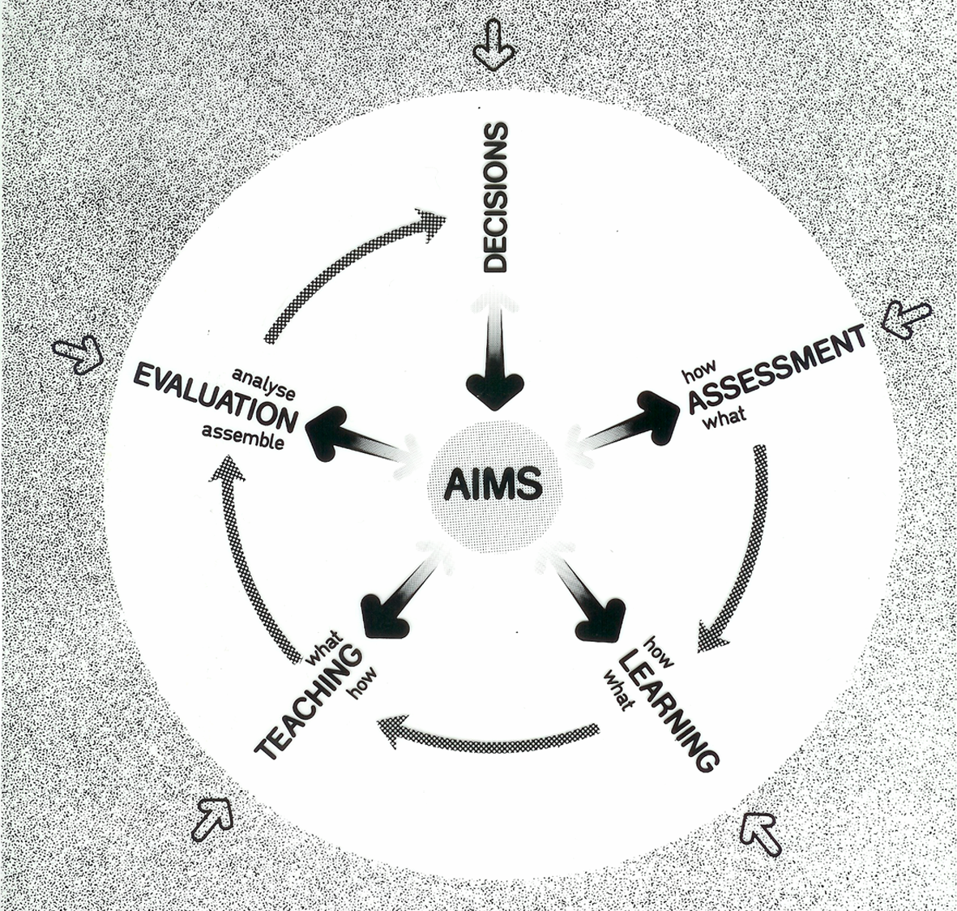
A Curriculum Development model
This model automatically secures alignment
learning outcomes
Cowan, 2004
Notes:
Learning outcomes are at the center of all we do in curriculum development – they come first in the process, followed by assessment!

Slide 6
2) On assessing higher level competences
The revised Bloom - cognitive taxonomy
creating
evaluating
Higher level competences
analysing
applying
Declared learning outcomes
Learning outcomes assessed
????????
Lower level competences
understanding
remembering
Changes in declared learning outcomes …
Notes:
From a situation with low level (or no) learning outcomes declared, to a situation with emphasis on higher level competences and learning outcomes – but there has not been a corresponding shift in assessment methods. Our assessment methods (at least the majority of them) are still constructed to measure low level competences.

Slide 7
…necessitates changes in assessment!
Higher level competences are more easily declared than they are measured
Assessing higher level competences necessitates new forms of assessment
Traditional forms of assessment of lower level competences are not sufficient any longer.

Slide 8
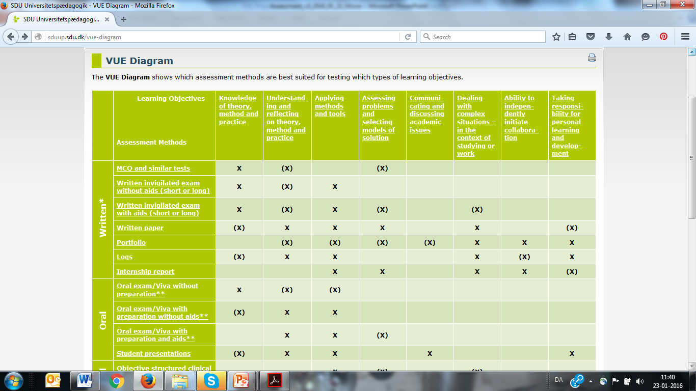

Slide 9
3) On assessing PBL related competences - 1
”PBL related competences are assumed to be learned from the very start of the studies.” (Erik’s slide)

Slide 10
Curriculum, TekNat Basis 1995
 | Exit level learning outcome – 1. year | P0-project unit (1 month) | P1-project unit (3 months) | P2-project unit (4 months)
Partial outcome 3: PBL related competences | Accomplish a problem oriented and project organised group work, including being able to:
Partial outcome 3a: Project management | Structure, plan and manage work processes in a problem oriented project work | Knowledge of work processes in a project work | Apply project work as study form | Plan and manage the P2 project work
Partial outcome 3b: Knowledge acquisition | Acquire knowledge which is relevant for the project work | Knowledge of acquirement of knowledge | Choose, describe and understand different methods of knowledge acquisition.. | Systematically choose methods of .. Critically evaluate the relevance of …
Own translation
Notes:
PO 3a illustrates why Bloom is not a good model for PBL related cmp. – students are also planning and managing project work in P0.
PO 3b has to some extent the same problem but is somewhat better because here the progression from P1 to P2 is secured through the use of adjectives – systematically and critically

Slide 11
3) On assessing PBL related competences
”The Dreyfus model might be a better model for grasping the intended progression in the PBL related competences” (Erik’s slide)
PBL related competences, such as, f. ex. collaboration, communication and learning to learn, include elements of competences from the affective domain

Slide 12
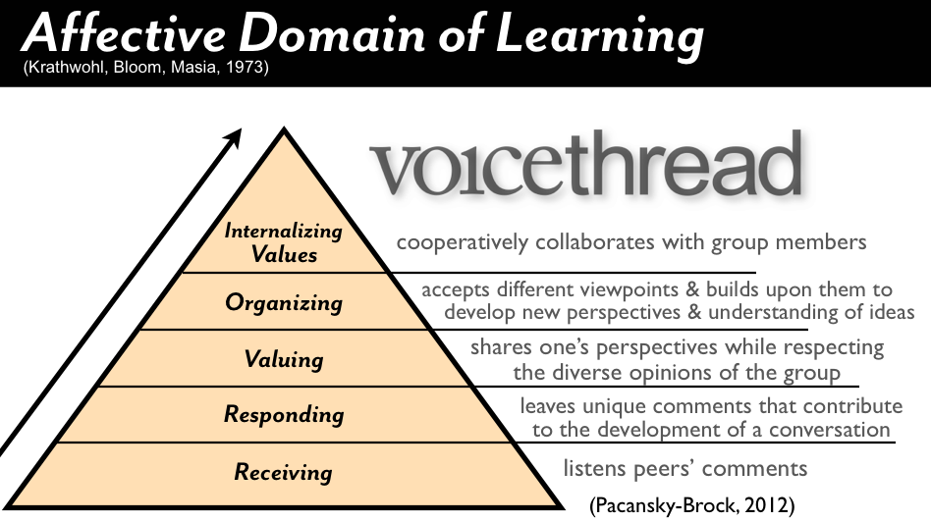

Slide 13
Questions for discussion:
Which forms of assessment do you normally use in your teaching?
How do you secure alignment between learning outcomes and assessment?
Please share any experience with ‘untraditional’ forms of assessment (portfolio, learning log, peer- and/or self- assessment).
To which extent is it possible to use a combination of Bloom’s cognitive and affective taxonomy and the Dreyfus model to formulate progressive learning outcomes for PBL related competences?

