Slide 1
Ensuring progression in student competencies with PBL
Organising education with PBL and progression
The Language and International Business Studies Programme (SIV) as a case in point
26 January 2016

Slide 2
Overview
Study programmes in the Humanities
PBL in the Humanities
Siv as a case in point
PBL in the SIV curriculum
A glance at selected steering documents supplementing the SIV study regulations
Points for further discussion.

Slide 3
Study programmes in the humanities
http://www.fak.hum.aau.dk/uddannelse/studieordninger/

Slide 4
PBL in the Humanities
Most study regulations in the Humanities describe a module for problem based learning, which is placed in the 1st semester. It describes learning goals in terms of knowledge, skills and competencies. Learning goals comprise academic as well as PBL competencies.

Slide 5
Language and International Business Communication (SIV) as a case in point
A word about SIV as a study programme
”International Business Communication in English is an internationally oriented study programme focusing on foreign languages and communication in companies and organizations. The programme provides training in professional communication with people and markets in other cultures” (my translation of SIV’s website presentation).

Slide 6
PBL in the humanities – a typical example (SIV)
[§ 9 the Module ”Problembased learning”
Placement: 1st semestre
Students’ workload: 5 ECTS
The module comprises an introduction to problem based learning and project work, including problem statement/ research questions, academic writing, information search and handling of search results, supervision and group work. ]

Slide 7
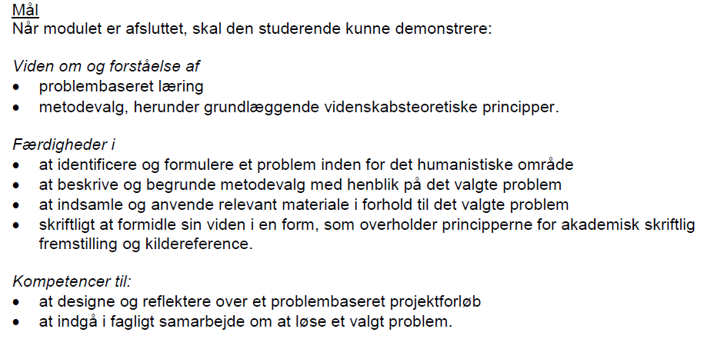
PBL in the Humanities - SIV
Notes:
Translation:
Learning goals:
At the end of the module, the student should demonstrate:
Knowledge and comprehension of
Problem based learning
Methodological choices, including basic principles of science of phisolophy
Skills in
Identifying and designing a problem statement (accounting for a problem complex) in the field of humanities
Describing and justifying methodological choices in relation to the problem identified
Collecting and applying relevant material (data) to analyse the problem identified
Communicating acquired knowledge in a form (style and language) that complies with principles of good academic writing, following an approved system for referencing.
Competences for:
Designing and reflecting on problem based project work.
Participating in professional collaboration to find answers to a specific problem/ issue.

Slide 8
PBL in the Humanities - SIV
[Translation: of Learning goals/ competence profile – preceding slide]
At the end of the module, the student should demonstrate:
Knowledge and comprehension of
Problem based learning
Methodological choices, including basic principles of science of philosophy
Skills in
Identifying and designing a problem statement (accounting for a problem complex) in the field of humanities
Describing and justifying methodological choices in relation to the problem identified
Collecting and applying relevant material (data) to analyse the problem identified
Communicating acquired knowledge in a form (style and language) that complies with principles of good academic writing, following an approved system for referencing.
Competences for:
Designing and reflecting on problem based project work.
Participating in professional collaboration to find answers to a specific problem/ issue.

Slide 9
PBL in the Humanities - SIV
[Translation]
Exam 1
An internal written and orall exam in: Problem Based Learning. The exam is held in combination with exam 2. Type of assessment: Pass/ fail (the 7-point grading scale is not applied)
Notes:
Translation:
Exam 1
An internal written and orall exam in: Problem Based Learning.
The exam is held in combination with exam 2.
Type of assessment: Pass/ fail (the 7-point grading scale is not applied)

Slide 10
From 1st to 10th semestre (SIV)
Competence profile for SIV Kandidatuddannelse (in extract):
Knowledge and comprehension of:
Indepth knowledge about theories and practices within the field of specialization
Ability to identify scientific problem issues and to reflect on a scientic basis
Specialized insight into a topic selected from within the core areas of the study programme
-----
Skills in:
On a scientific basis to apply a critical approch to the methods and theories of the field studied.
To delimit a problem area and problem analysis
To view a problem from different perspectives in new contexts (ability to perspectivize)
To communicate and discuss complex issues in a well-argued language and style.
Competencies:
To argue on a scientific basis
Independently and on a scientific basis to take responsibility for further personal and professional development and specialization
Notes:
Progression in knowledge, skills and competencies seems to be ensured in the study regulations through a more nuanced descriptions such as:
Knowledge: Indepth knowledge, identify scientific problem areas, scientific reflection, specialized insight …
Skills: apply a scientific and critical approach to, add new perspectives to a problem area, discuss complex problems in a well-argued way
Competences: argue from a scientific basis, show independence at a scientific level

Slide 11
A glance at selected steering documents supplementing the SIV study regulations
SIV group work template
How to shift to another projekt group
Project supervision template(supervisors and external examiners)
Guidelines for project work (2nd to 6th semestre)
Guidelines for written exams (School of Culture and Global Studies)
Student handbook (”Kandidat” study programme)
Source: Moodle, School of Culture and Global Studies, SIV.

Slide 12
Points for further discussion
To what extent can we ensure PBL progression by means of the study regulations only (progression in wording – enhanced requirements from 1st semestre to 10th semestre)?
Could supplementary steering instruments be a solution? (e.g. testifiable through a personal progression portfolio that follows the student for the duration of a study programme)
What is the role of the supervisor (how might cluster supervision assist the assessment process)?

