Slide 1
Progression & the PBL Generic Competencies
Models & Assumtions
Erik Laursen
PBL Academy Aalborg University

Slide 2
The background for discussing progression
New demands concerning visible and well documented study progression . Plus -
Demonstrated visibility in how students are expected to achieve the knowledge , skills and competencies defined as the learning goals,
So, - we need to be more explicit in how we work with progression
As well as in how our choices of teaching methods , evaluation methods and pedagogy are expected to contribute to the progression of student development

Slide 3
Themes for this presentation
The distinction between the professional - and PBL generic skills
What could be a good model for the progression of PBL generic skills?

Slide 4
1. Professional – and PBL generic competencies

Slide 5
The twofold intentions of the PBL model
To develop PBL generiske competencier
ex : udvikle evner til akademisk samarbejde i grupper, omkring arbejde med faglige problemer
To support the development of professionel competencies & knowledge
ex: tilegnelse af teoretisk viden i forbindelse med anvendelse af teorier i problem analyser.

Slide 6
Likewise progression and PBL have two aspects….
Progression in the PBL generic competencies
Progression in the professional competencies, where learning are supported by PBL.

Slide 7
A difficult line of distinction to draw
(between the professional – and the PBL generic skills)
Ex : To delimit - , conceptualize - and analyze professionally relevant problem .
The distinction is clearly drawn differently in different studies.
This diversity is legitimate but it complicates an interdisciplinary discussion of the PBL generic skills

Slide 8
2. Images of progression

Slide 9
The idea of progression in studies is based on…
A belief in the necessity of a certain order of the elements of knowledge, included in a study.
That means, that the order of the elements to be learned through the course of study is not accidental.
This belief is backed up by two arguments for the necessities of order

Slide 10
Two arguments in favour of the necessity of order
1. The Requirement Argument:
the acquisition of a particular knowledge or skill x should 'come before' y, because the acquisition of y, so to speak 'requires' the previous acquisition of x
2. The Complexity Argument:
The advanced elements of a necessary learning order not only constitute a 'precondition' for the following items, but should be regarded as more 'elementary’ or 'fundamental' than the subsequent, more 'complex' element.
This includes the idea that complex learning elements require a more advanced students, while the most basic learning elements can be assimilated by the unprepared, but tenacious and motivated students.
Notes:
Requirement argument : one must learn the meaning of the concept of ’capital city’ before one is able to learn the ’names of the capitals n the states of Europe’

Slide 11
The legitimacy of the two arguments
The requirement argument Is typically based on practical experience (it is difficult to teach children to divide, if they have not previously learned addition ) and are normally accepted without too much discussion .
The Complexity Argument is typically based on theoretical and scholastic assumtions and are often the subject of discussion and criticism. Eg. In connection with Bloom's Taxonomy .

Slide 12
3. What is A ”good model” for the progression in the pbl generic competencies ?

Slide 13
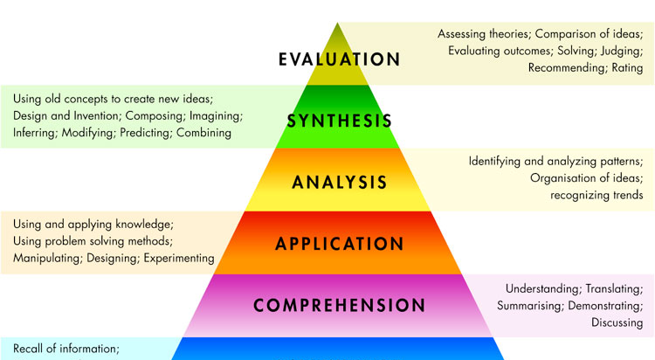
Progression by adding new elements
Blooms taxonomy

Slide 14
Progression by the growing complexity of the elements
The Dreyfus Model
1. Novice Context free . Rule following. None Analytic Detached
2. Advanced beginner Context free and situational. None Analytic. Detached
3. Competent Context free and situational.
Chosen. Analytic detached understanding and deciding; involved outcome
4. Proficient Context free and situational. Experienced, Analytic Involved understanding; detached deciding
5. Expert Context free and situational Experienced. Intuitive Involved

Slide 15
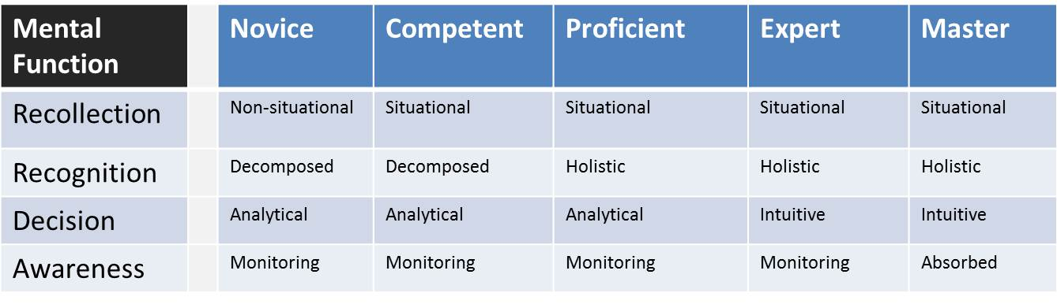
The Dreyfus Model

Slide 16
An often overlooked aspects of the PBL Model is…
The totality of all PBL – generic Competencies is assumed to be learned (to some extent) from the very start of the studies.. ( 1.semester project is typically planned as a " mini research project " )
The progression is assumed to be a progression of already existing competences (apart from 1. semester) and not a
gradually adding of new competencies.

Slide 17
Bloom or Dreyfus ?
The Progressionen in Blooms taxonomy is produced by adding new elements with an assumed growing complexity.
The Progressionen in the Dreyfus Model is assumed to take place through a reorganisizing of allready adapted competencies .
Because of this , the Dreyfus Model might be a better model, grasping the intended progression in the PBL generic competencies ?

