Slide 1
PROBLEM BASED LEARNING (PBL) ”the aau model”
02.09.2016

Slide 2
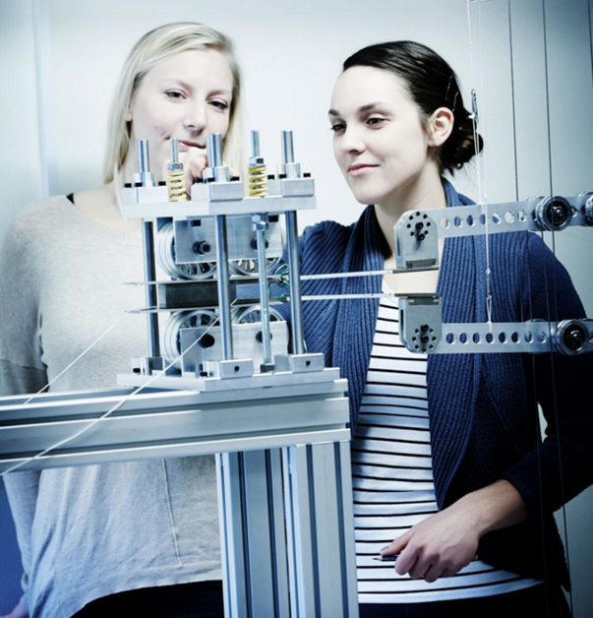
THE PHILOSOPHY OF PBL
The PBL-model assumes that students learn best when applying theory and research based knowledge in their work with an authentic problem.
At the same time, the model supports students in the development of their communication and cooperation competences and in acquiring the skills required when taking an analytical and result-oriented approach.

Slide 3
THE IDEA OF PBL
The AAU model includes project work based on authentic problems, self-governed group work and collaboration.
The AAU model provides students with tools for independent acquisition of knowledge, skills and competences at an advanced academic level.
During their studies, many students
will also have the opportunity to cooperate with external partners on the solution of scientific problems.

Slide 4
BASIC PRINCIPLES OF PBL
Project organisation creates the framework of problem based learning
Courses support the project work
Cooperation is a driving force in problem based project work
The problem based project work of the groups must be exemplary
The students are responsible for their own learning achievements
All educational activities at Aalborg University involve
Problem based project work, which takes as its point of departure a set of principles that constitute the AAU model of problem-based learning (PBL).

Slide 5
TYPICAL COMPONENTS IN PBL PROCESS
Supervisors present the thematic framework of the semester
Students brainstorm on ideas for projects and form groups
Students produce an early problem formulation
The students will have to:
Find a problem and case, identify methods on how to investigate the problem (purely theoretical, through interviews, video-observation and analysis, questionnaires, ethnographic observation etc.)
Discuss their methods, and why they investigate their problem in a particular manner
Identify theories or theoretical concepts that will help them understand their problem
(Often) conduct empirical investigations, that are analysed
All this is done in collaboration with the supervisor, who helps the students to identify relevant methods, theories etc.

Slide 6
THE PBL PROCESS
Literature
Lectures
Group Studies
Problem
Analysis
Problem
Solving
Project
Report
Tutorials
Field
Work
Experiments

Slide 7
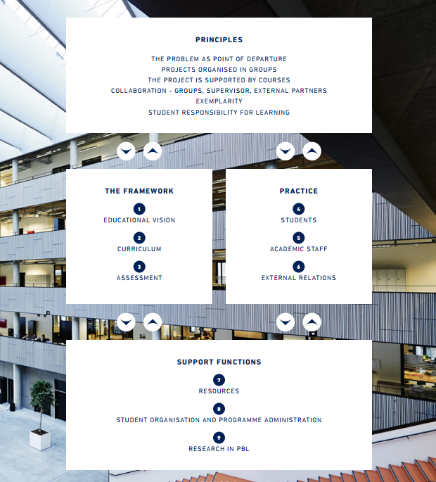
The figure illustrates the interaction between the AAU model’s basic principles of PBL, the educational framework, stakeholders, practices and support functions at Aalborg University.

Slide 8
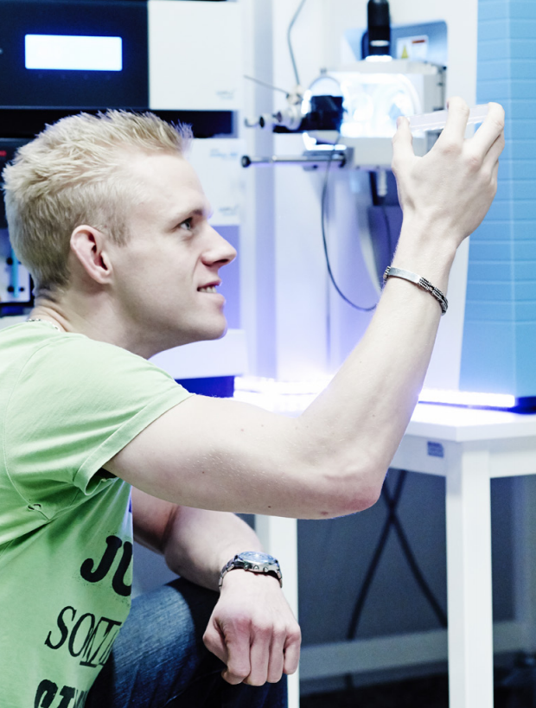
EDUCATIONAL VISION
1
Aalborg University has a clearly articulated vision for problem-based project work and learning in all its study programmes.

Slide 9
CURRICULUM
2
The AAU model’s basic principles are incorporated into all curricula at the university.

Slide 10
ASSESMENT
3
The project work is completed by an examination which assesses students’ individual performances in the project work.
Emphasis is on the assessment of the individual student’s knowledge, skills and competences.
The assessment takes place in connection with the students’ presentation and discussion of their project, including the approach taken
and the results achieved by the group.

Slide 11
STUDENTS
4
Students at Aalborg University engage in project based work, and all students receive an early introduction to the AAU PBL model and the reasons for its application.

Slide 12
ACADEMIC STAFF
5
All academic staff at Aalborg University implement the AAU model in their pedagogical activities.
All academic staff are introduced to the AAU model and its implementation through in-house activities, continuing education courses etc.

Slide 13
EXTERNAL RELATIONS
6
Working with authentic issues implies that the university maintains close contact with external organisations.

Slide 14
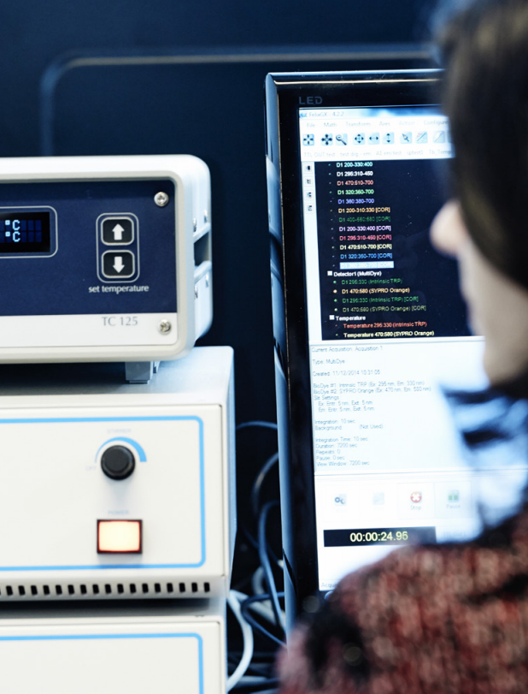
RESOURCES
7
The university acquires and deploys resources in ways
That consistently support the AAU PBL model.

Slide 15
STUDENT ORGANISATION AND PROGRAMME ADMINISTRATION
8
The administration of the study programmes is undertaken primarily by schools, student councils and study boards as well as by support staff. Administrative decisions regarding study programmes are made in schools and study boards. Within each study programme, semester coordinators are appointed; these will have an overview of the programme details for that semester.
The university has established organisational and administrative structures which facilitate efficient and development-oriented application of the AAU model. This is implemented through cooperation between schools, student councils and study boards.

Slide 16
RESEARCH IN PBL
9
Aalborg University conducts targeted research within
Problem based and project oriented learning.
Research in PBL is, to a certain extent, based on university
evaluation results, enabling the university to document results
and adapt and develop the AAU PBL model.

Slide 17
KNOWLEDGE FOR THE WORLD
Aalborg UniversitY strategi 2016 - 2021

Slide 18
VISION FOR PROBLEM BASED LEARNING
AAU is internationally recognised for our problem and project based learning and the documented results of this learning method.
All our students and staff act out our basic principles of problem and project learning, which is a general feature in all programmes at the university.
IT is an integral part of problem and project based learning.

Slide 19
ACTIONS PROBLEM BASED LEARNING
Identify existing research results of our PBL practice
A number of research and educational development projects will be launched
AAU’s PBL principles are being continuously reassessed
IT will be integrated directly in the model

Slide 20
ACTIONS PROBLEM BASED LEARNING
The schools will develop their programmes on the basis of the PBL principles updated in 2015
The integration of PBL as an explicit learning objective in the curricula and regulations of all study programmes will be ensured.
New staff will receive systematic introduction to PBL
The heads of departments will prepare a plan for and ensure the on-going upgrading of the PBL and IT competences of teaching staff

